Slide 1
Hypothesis
Presentation
Madison O’Quinn
James Philips
Chad Harris
Brandon Underwood

Slide 2
Presentation Outline
Research Question
Initial Hypothesis
How we got here
Why we changed
Our data sources
Our data quality
What we derived from the data
Next steps
New hypothesis
Notes:
DELETE SLIDE

Slide 3
Research Question
Do major storms have an effect on crop yield?
Notes:
This question led to our formal hypothesis...

Slide 4
Initial Hypothesis
Major storms will have a negative
impact on crop yield.
Notes:
Meaning there should be a correlation between loss of crops and storm frequency
or
there should be a correlation between loss of crops and severity of storm.
DELETE WILL

Slide 5
How we got here:
Original question:
How does pollution affect crop yield
Notes:
Main Reasons we changed:
Pollution is hard to define. Does it mean runoff, air pollution, pesticides.
Moreover, how do you define what is a pollutant?
We had trouble finding useful data. We were able to find tons of crop data but this data is for the state level.
To actually determine the effect of any pollutant on crop yield we would need data for the county level at the highest.

Slide 6


Our data sources

Slide 7
Our data quality
Crops
63
68
73
Weather
71
79
89
Notes:
Middle value is the average
Overall our data quality was pretty good.
The quality for the weather data is exceptional though.

Slide 8
What we derived from the data
Notes:
Next Slide

Slide 9
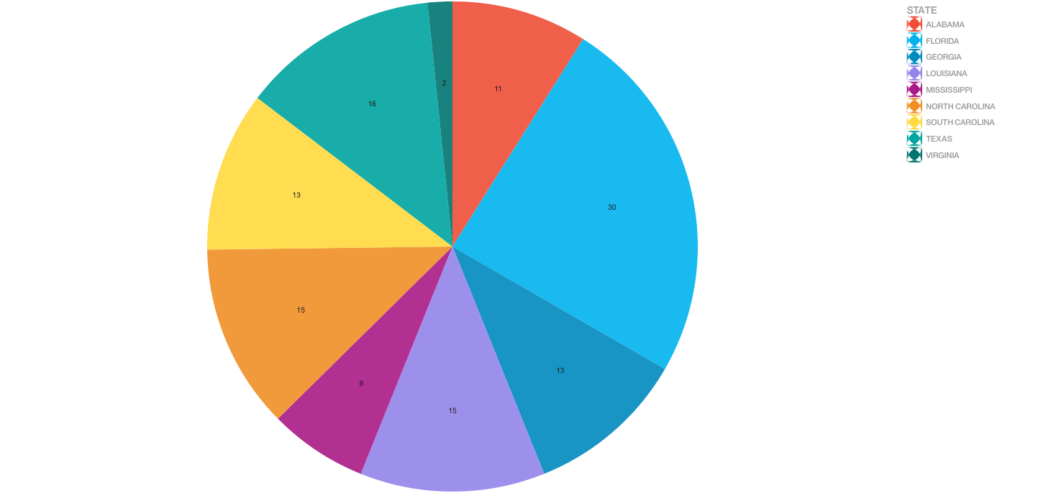
Which state has been the most?
Notes:
Florida is the blue.
Most other states had similar numbers with Virginia and Mississippi being the exceptions.

Slide 10
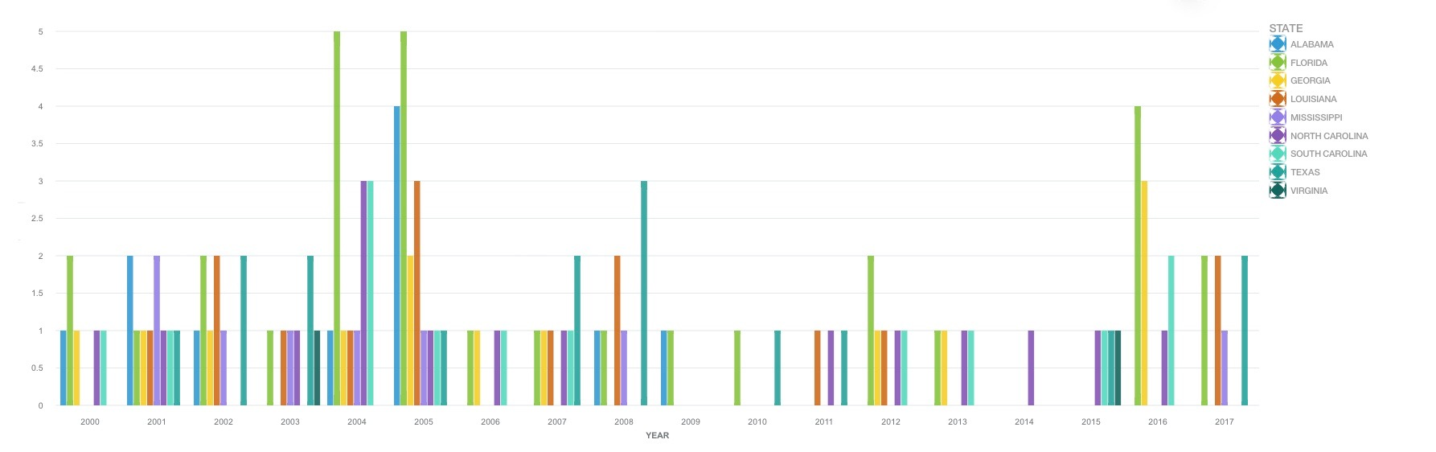
Number of storms by year
Notes:
This shows the number of storms that hit each state by year.
Consistently Florida receives several storms per year.
Meanwhile states like Virginia are barely on this graph.

Slide 11
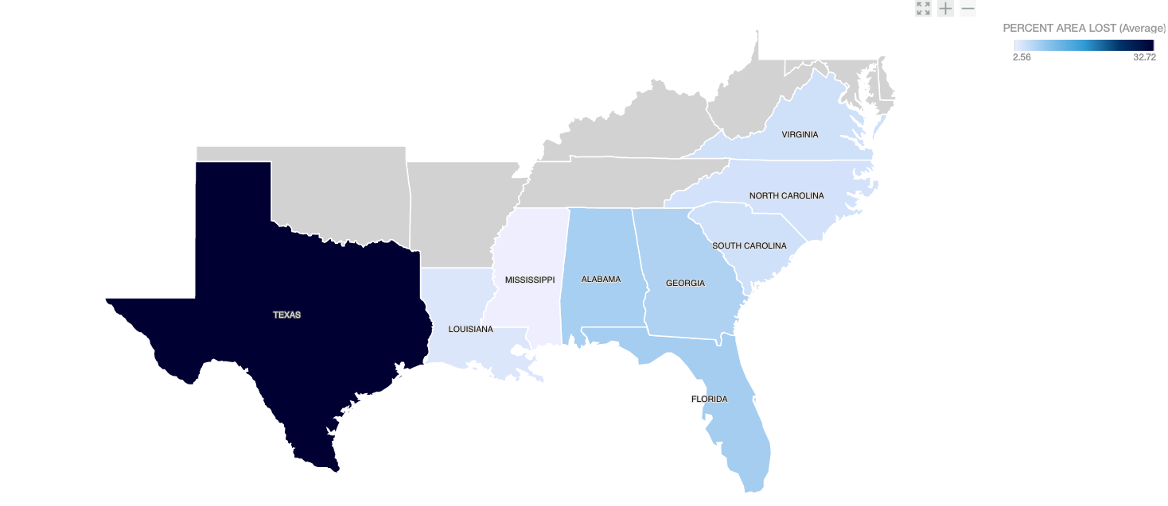
Average Loss by state
Notes:
This is a normalized value for percent lost of the area planted.
As can be seen Texas has the highest average loss and most of the other states have similar percent losses.

Slide 12
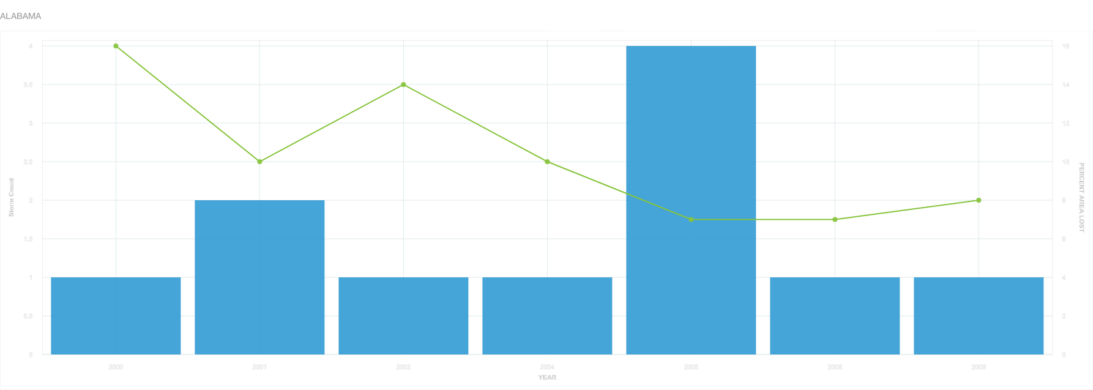
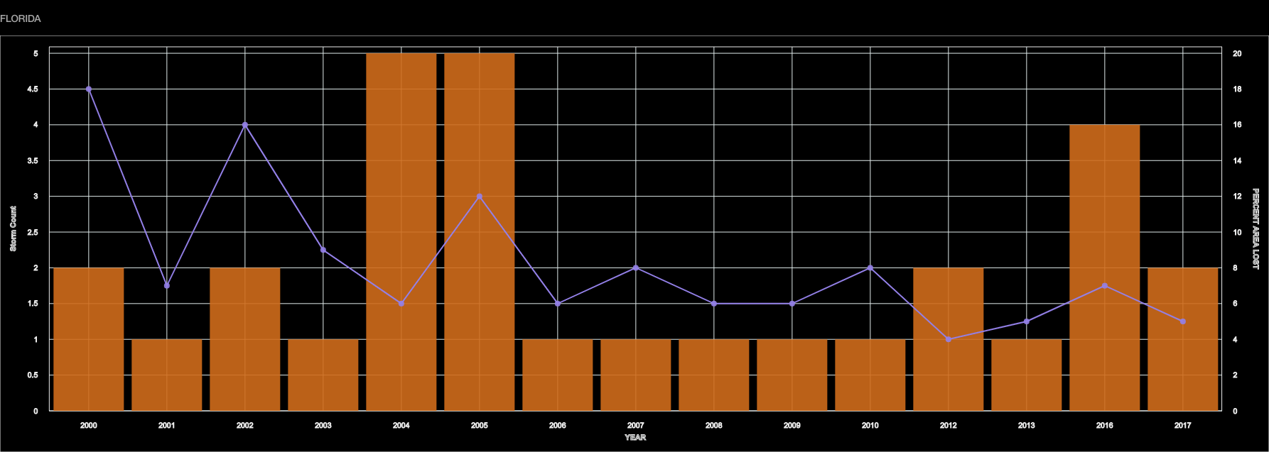
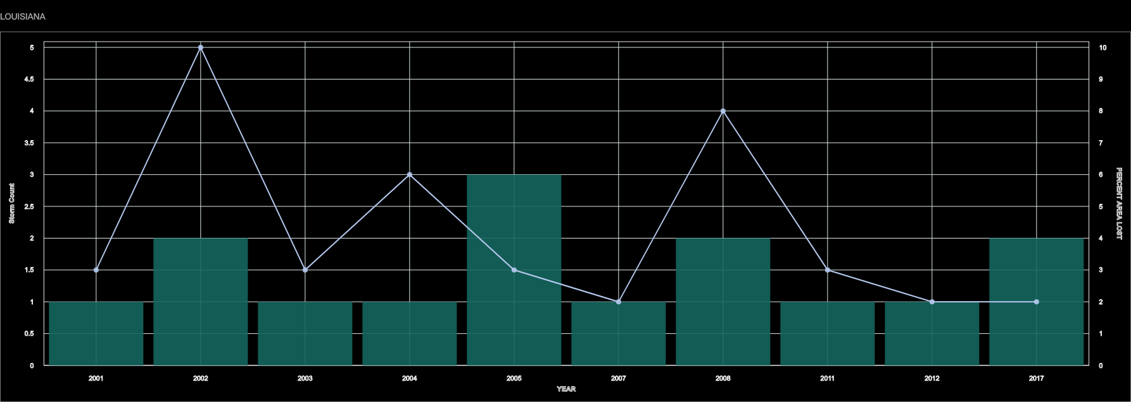
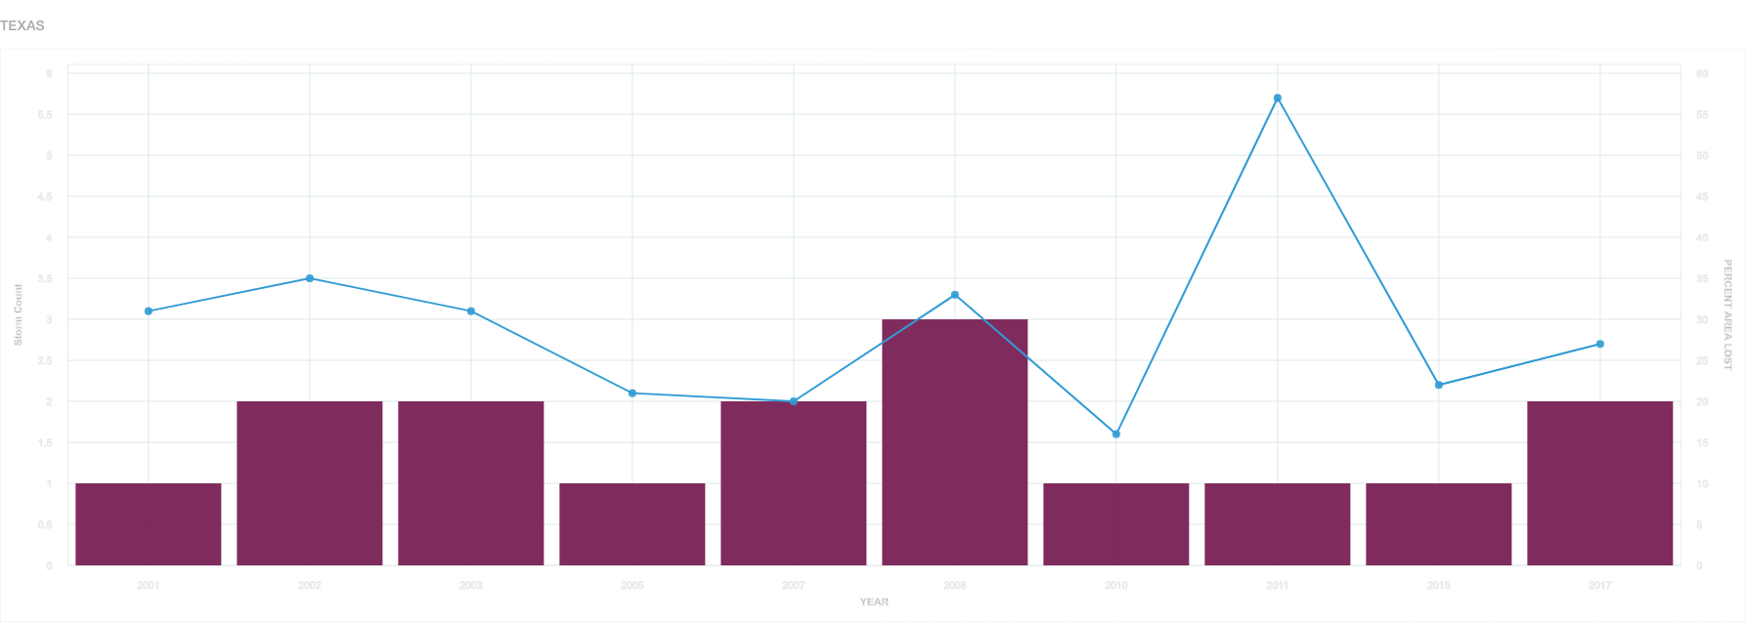
Number of storms vs Loss
Notes:
Order is AL, FL, LA, TX
Each graph is a hyperlink to enlarged version.
We had the expectation that the loss would be heavily affected by the number of storms
Our Conclusion: We did not find any correlation, in fact there were years where there were many storms and the loss was very low and vice versa.

Slide 13
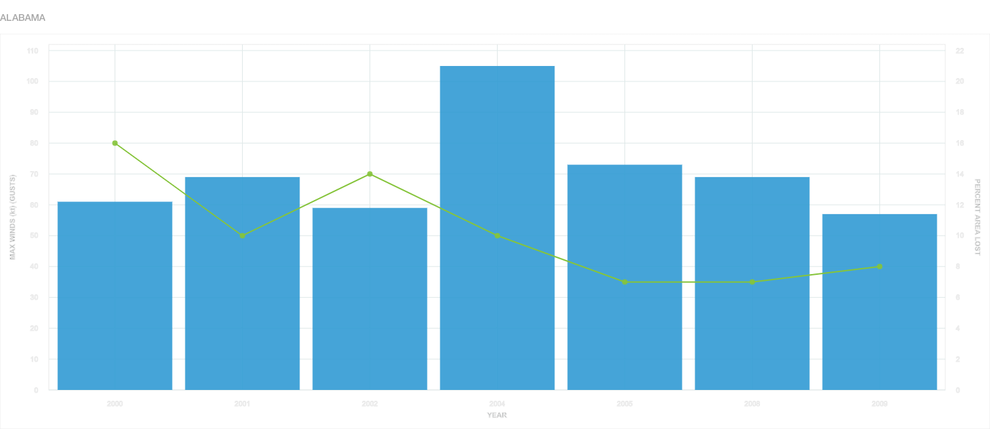
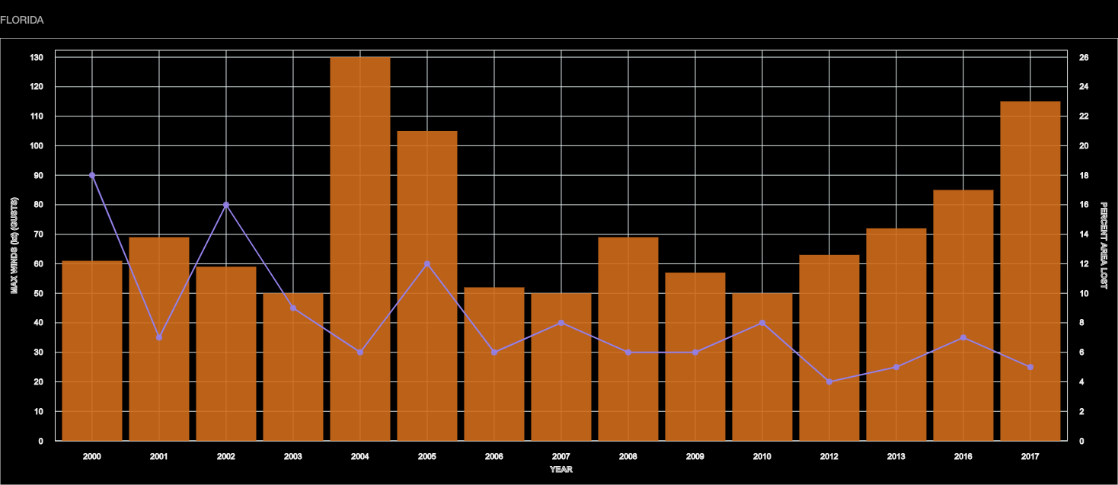
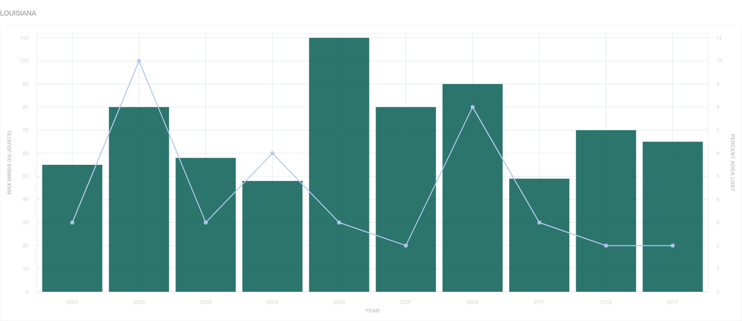
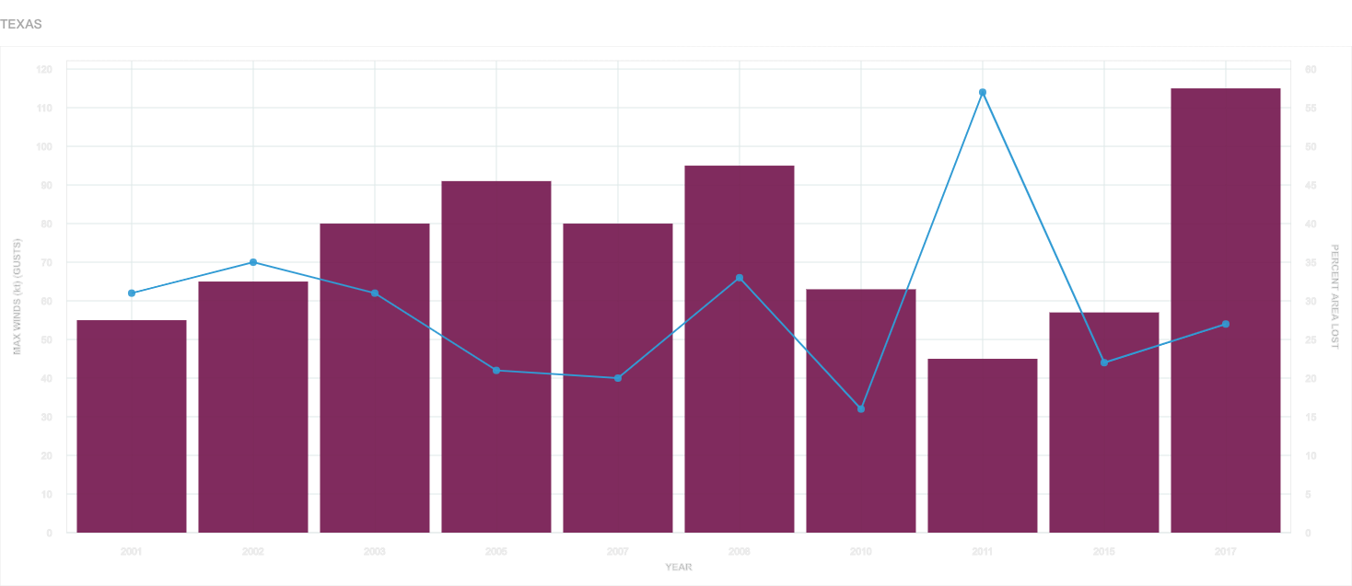
Storm Severity vs Loss
Notes:
Order is AL, FL, LA, TX
Each graph is a hyperlink to enlarged version.
Expectation was that higher wind speed would cause greater loss of crops.
Conclusion: There was no correlation between max wind speed and loss.

Slide 14
Our conclusion
We found no correlation between loss of crops and storm frequency or severity.

Slide 15
Next steps
Look at other potential factors
such as drought
Notes:
Where are we going from here?
Looking at other potential factors.
It is clear from the crop yield data that there is some factor causing crop loss.
We have to figure out what that factor is.
The main factor we want to look at is how drought affects crop yield. We think there may be a correlation between drought and crop loss.

Slide 16
END

Slide 17
Alabama

Slide 18
Florida

Slide 19
Louisiana

Slide 20
Texas

Slide 21
Alabama

Slide 22
Florida

Slide 23
Louisiana

Slide 24
Texas

